Slide 1
Regular Expression
Lecture 4

Slide 2
Topics
Introduction to Regular Expression
RE & NFA
NFA & RE
Regular Languages
Pumping Lemma for Regular Languages
Source:"Introduction to automata theory, languages and computation"
by JE Hopcroft, R Motwani and JD Ullman.

Slide 3
Regular Expression
It is a sequence of characters that define a search pattern. Used in pattern matching with strings, or string matching.
Eg: "find and replace"-like operations.
Text Editors

Slide 4
Equivalence with Finite Automata
Regular Expressions(RE) and finite automata are equivalent in their descriptive power.
Any RE can be converted in to a finite automaton that recognize the language it describes.

Slide 5
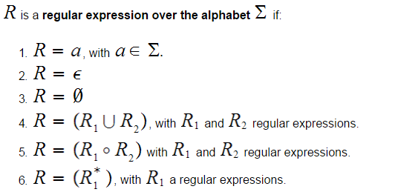
Regular Expression

Slide 6

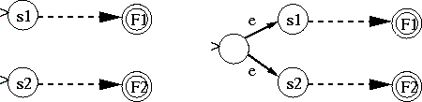
NFAs & Regular Expressions
For any regular expression, we can find an equivalent NFA
1)
2) x
y
X U Y or X+Y

Slide 7
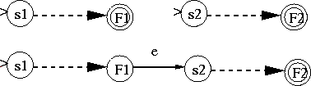

NFAs & Regular Expressions
3)
X*
4)
X
Y
XY
X

Slide 8
Rules for Regular Expression
State Elimination Method
Rule 1:Add new Initial state
Initial state should not have any incoming edge.
Add Epsilon and change the initial state
q0
q1
ε
q0
q1
q2

Slide 9
Rules for Regular Expression
Rule 2:Add new final state
Final state should not have any outgoing edges.
ε

Slide 10
Rules for Regular Expression
Rule 3:Eliminate more number of final state
Rule 4:Eliminate all the other states one by one except initial and final state
ε
ε
ε

Slide 11
Example 1- FA to RE
a
RE : a + b + c
b
c

Slide 12
Example -2
b
a
c
RE : ab* c

Slide 13
Example -3
0
0
1
RE: 0(01)*
ε

Slide 14
Example-4
b
a c
d
ε
ε
ε
RE: a(b+c+d)

Slide 15
Example-5
0
0
1
ε
ε
1
RE: (10*1+0)*

Slide 16
Example-6
0
0
0
1 1
ε
1
RE: (10*10*1+0)*

Slide 17
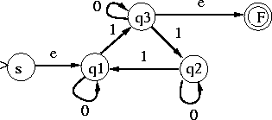
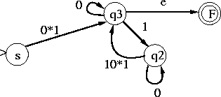
Example-7
NFA:
Eliminate q1, paths eliminated are:
s → q1 → q3 and q2 → q1 → q3 that gives

Slide 18

Example-7
Eliminating q2 (path q3 → q2 → q3)
Produce

Slide 19


Example-7
Eliminating q3
Gives
L(M) = 0*1(0 ∪ 10*10*1)*

Slide 20
How to show a language is Regular?
Theorem 1: A language L is accepted by a DFA iff L is accepted by an NFA iff there is a regular expression for L
A language L as above is known as a regular language
To show that a language is regular, give one of the following for it:
Define it using a regular expression
Build an NFA that accepts its strings
Build a DFA that accepts its strings

Slide 21
How to show a language is not Regular?
Show that it doesn’t satisfy the pumping lemma.
If it contains a string w, longer than a specific n, w cannot be pumped.
Specifically, this is established by showing that any splitting of w into x y z,
where y is not empty, and |x y| ≤ n, doesn’t allow pumping y, i.e. x y^{i} z ∉ L, for all integer i ≥ 0.

Slide 22
FSAs & ‘pumping’
FSA can be built to accept strings having predictable cycles
thus regular languages can have cycles
Pumping a string refers to constructing new strings by repeating (pumping) substrings in the original string
e.g. FSA for ab^{n}a
pump-up aba to abba - still accepted

Slide 23
Statement of Pumping Lemma
If L is a regular language, then there is a number n (pumping length) where, if s is any string in L of length at least n, then s must be able to be divided into three pieces, s = xyz, satisfying the following conditions:
1. |xy| ≤ n
2.|y| > 0, and
2. for each i ≥ 0, xy^{i}z ∈ L,

Slide 24
Describing the pumping lemma (contd.)
Take string
with
There is a walk with label:
w₁
w₂
w_{n}
s₁
.........
s_{n-1}
s_{n}
s₀

Slide 25
Describing the pumping lemma (contd.)
If string has length
, number of states.
Then, a state is repeated in the walk
......
......

Slide 26
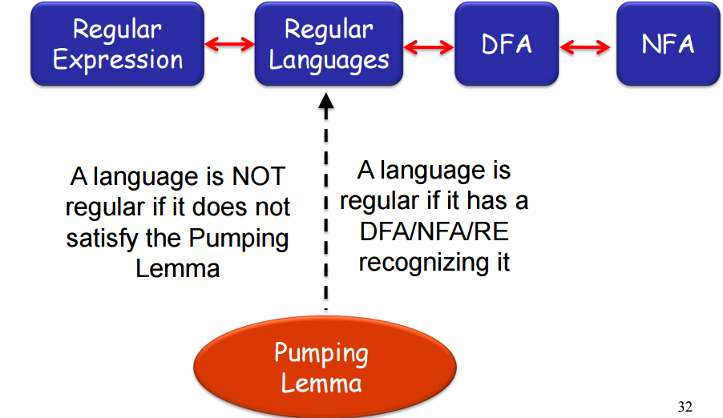
Regular Languages

Slide 27
Example-1
a^{n} b^{n}
Test the expression passes pumping lemma test.
L={ a¹b¹,a²b²,a³b³…..a^{n}b^{n}}
Consider a³b³
Can be written as aaabbb
Length of the string is 6

Slide 28
Example-1(contd)
Rule 1: split the expression with form (xyz)
x=aa y =abb z=b
Rule 1: Apply rule |xy|<n .Length of XY is 5
xy=5 then |5|< 6
Rule 2: |y| >0
y=3 hence 3>0

Slide 29
Example-1(contd)
Rule 3: xy^{i}z ∈ L,
Assume i=2
Then xyz becomes
x y y z
aa abb abb b
This can be written as a^{n}b^{n-1}ab^{n}
Conclusion:
This expression is not supported in the language.Hence the language is not regular

Slide 30
References
Sipser,Chapter -1

